Slide 1
Estimating SARS-CoV-2 transmission from a representative prevalence survey: progress and challenges
Joshua Blake
MRC Biostatistics Unit, University of Cambridge
@JoshBiostats
joshuablake.co.uk

Slide 2
Epidemic surveillance data is messy
Notes:
Hopefully everyone agrees! Eg: ascertainment bias.

Slide 3
Designed studies are better
Notes:
- What is a designed study? Main point: population of interest is well-defined, we understand how our sample is formed, and why we have the data we do

Slide 4
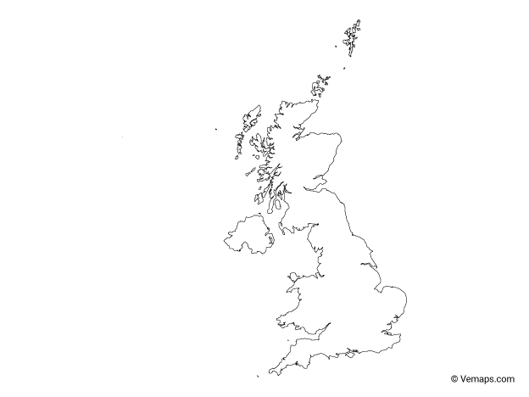
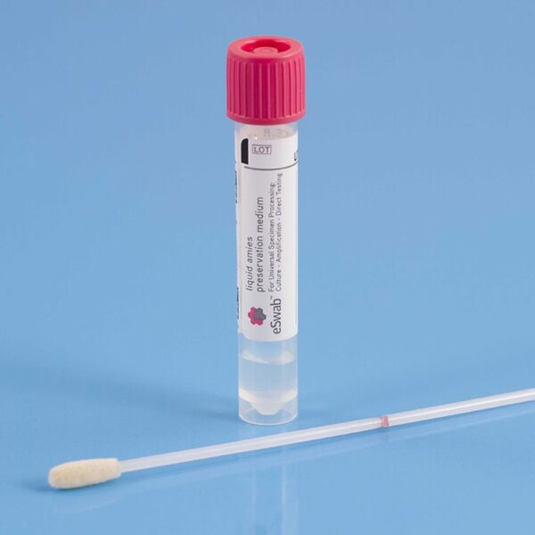
Coronavirus Infection Survey (CIS)
Visits
Notes:
Population: private households in UK (well defined)
Recruited randomly (understood process)
Tested on a schedule (no ascertainment bias)
Big: ~15k tests / day in 2020

Slide 5
How can we best utilize CIS to answer questions about transmission?
Notes:
Timing: 1.5 min gone

Slide 6
Transmission ≈ incidence
CIS measures prevalence
Notes:
Questions about transmission are very related to questions about incidence: how many infections and in whom, how is this changing?

Slide 7
Prevalence = incidence x duration
Freeman and Hutchinson. “Prevalence, Incidence and Duration.” American Journal of Epidemiology (1980)
Notes:
Classic epidemiology
Assumes steady-state, but SARS-CoV-2 changes rapidly (doubly times < duration)

Slide 8
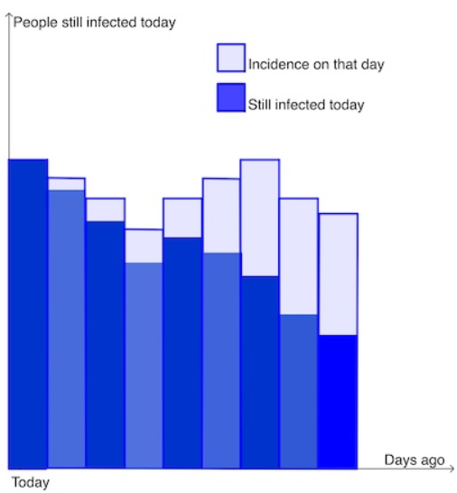
$$Prevalence\left(t\right)=\sum_{τ=0}^{∞}{Incidence\left(t−τ\right)S\left(τ\right)}$$
$S\left(τ\right)$ = $ℙ$(duration of positivity $≥τ$)
https://plus.maths.org/content/keeping-covid-19
Notes:
People prevalent now (dark blue) are everyone infected today, those infected yesterday whose infection lasts at least 1 days, those infected two days ago whose infected lasts at least 2 days, and so on.
Strictly only true in expectation

Slide 9
Problem: no ideal studies for PCR duration estimation
Idea: combine data from two complementary studies
Notes:
- Aren’t existing estimates from a general population cohort with long follow-up
- Ideal: estimate this from frequent testing of such a cohort
- This data doesn’t exist
Timing: 2.5 min

Slide 10
Complementary studies
ATACCC (Hakki et al. (2022), Lancet Resp Med)
Frequent sampling
Short follow-up
Small sample size
CIS
Infrequent sampling
Long follow-up
Large sample size

Slide 11
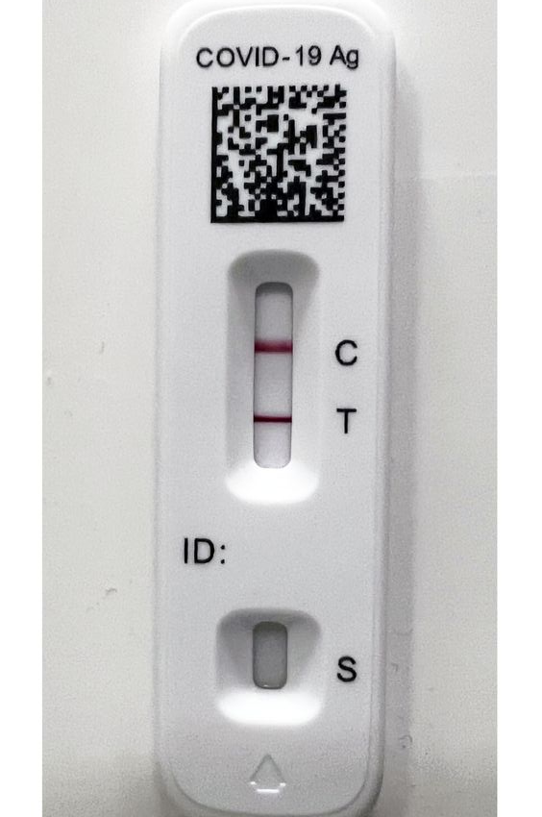
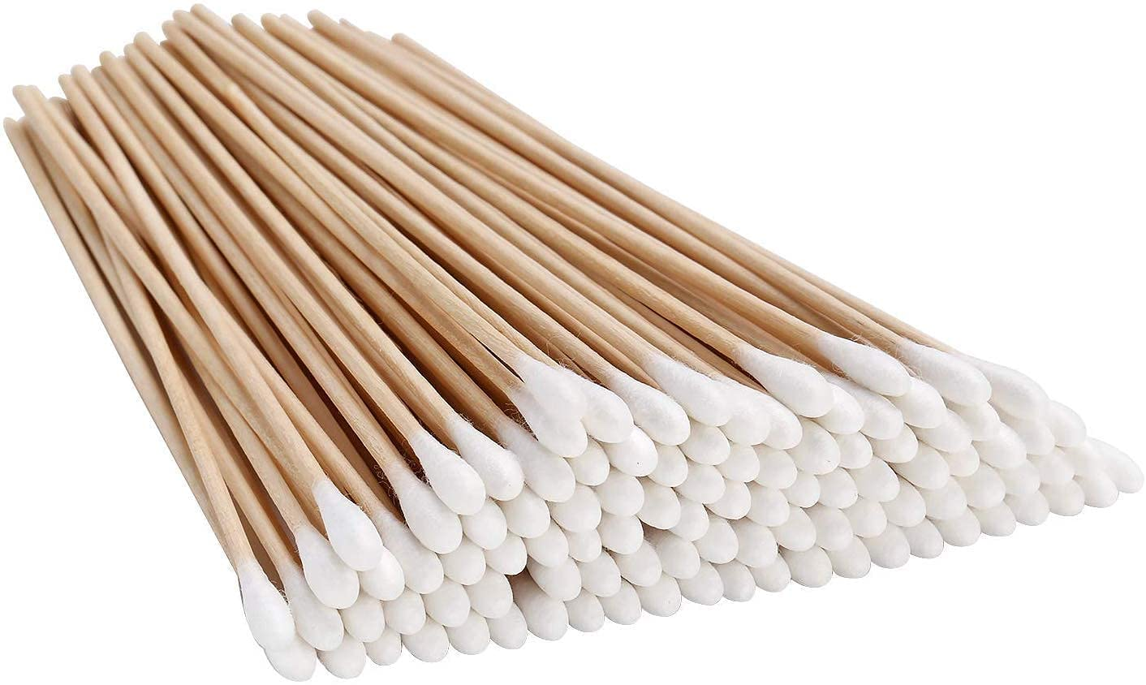
ATACCC study design
Adaptation of Hakki et al. (2022), Lancet Resp Med
Notes:
Confirmed positives (actually PCR in this period)
Contacts reported to NHS T+T
Contacts swabbed + PCR tested daily for 20 days

Slide 12
Model viral load
Bayesian hierarchical (random effects) model
Exponential growth then decay of viral load
Negatives due to low viral load or false negative
Adaptation of Hakki et al. (2022), Lancet Resp Med
Notes:
False negative model = difference from Hakki et al., helps convergence

Slide 13
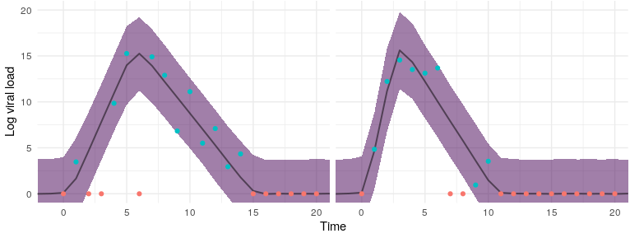
Viral load results
Duration
Adaptation of Hakki et al. (2022), Lancet Resp Med
Notes:
- Example of model fit. Point out false negatives.
- Duration: time from viral load increasing to return to 0
- Integrating over the individual-level parameters leads to…

Slide 14
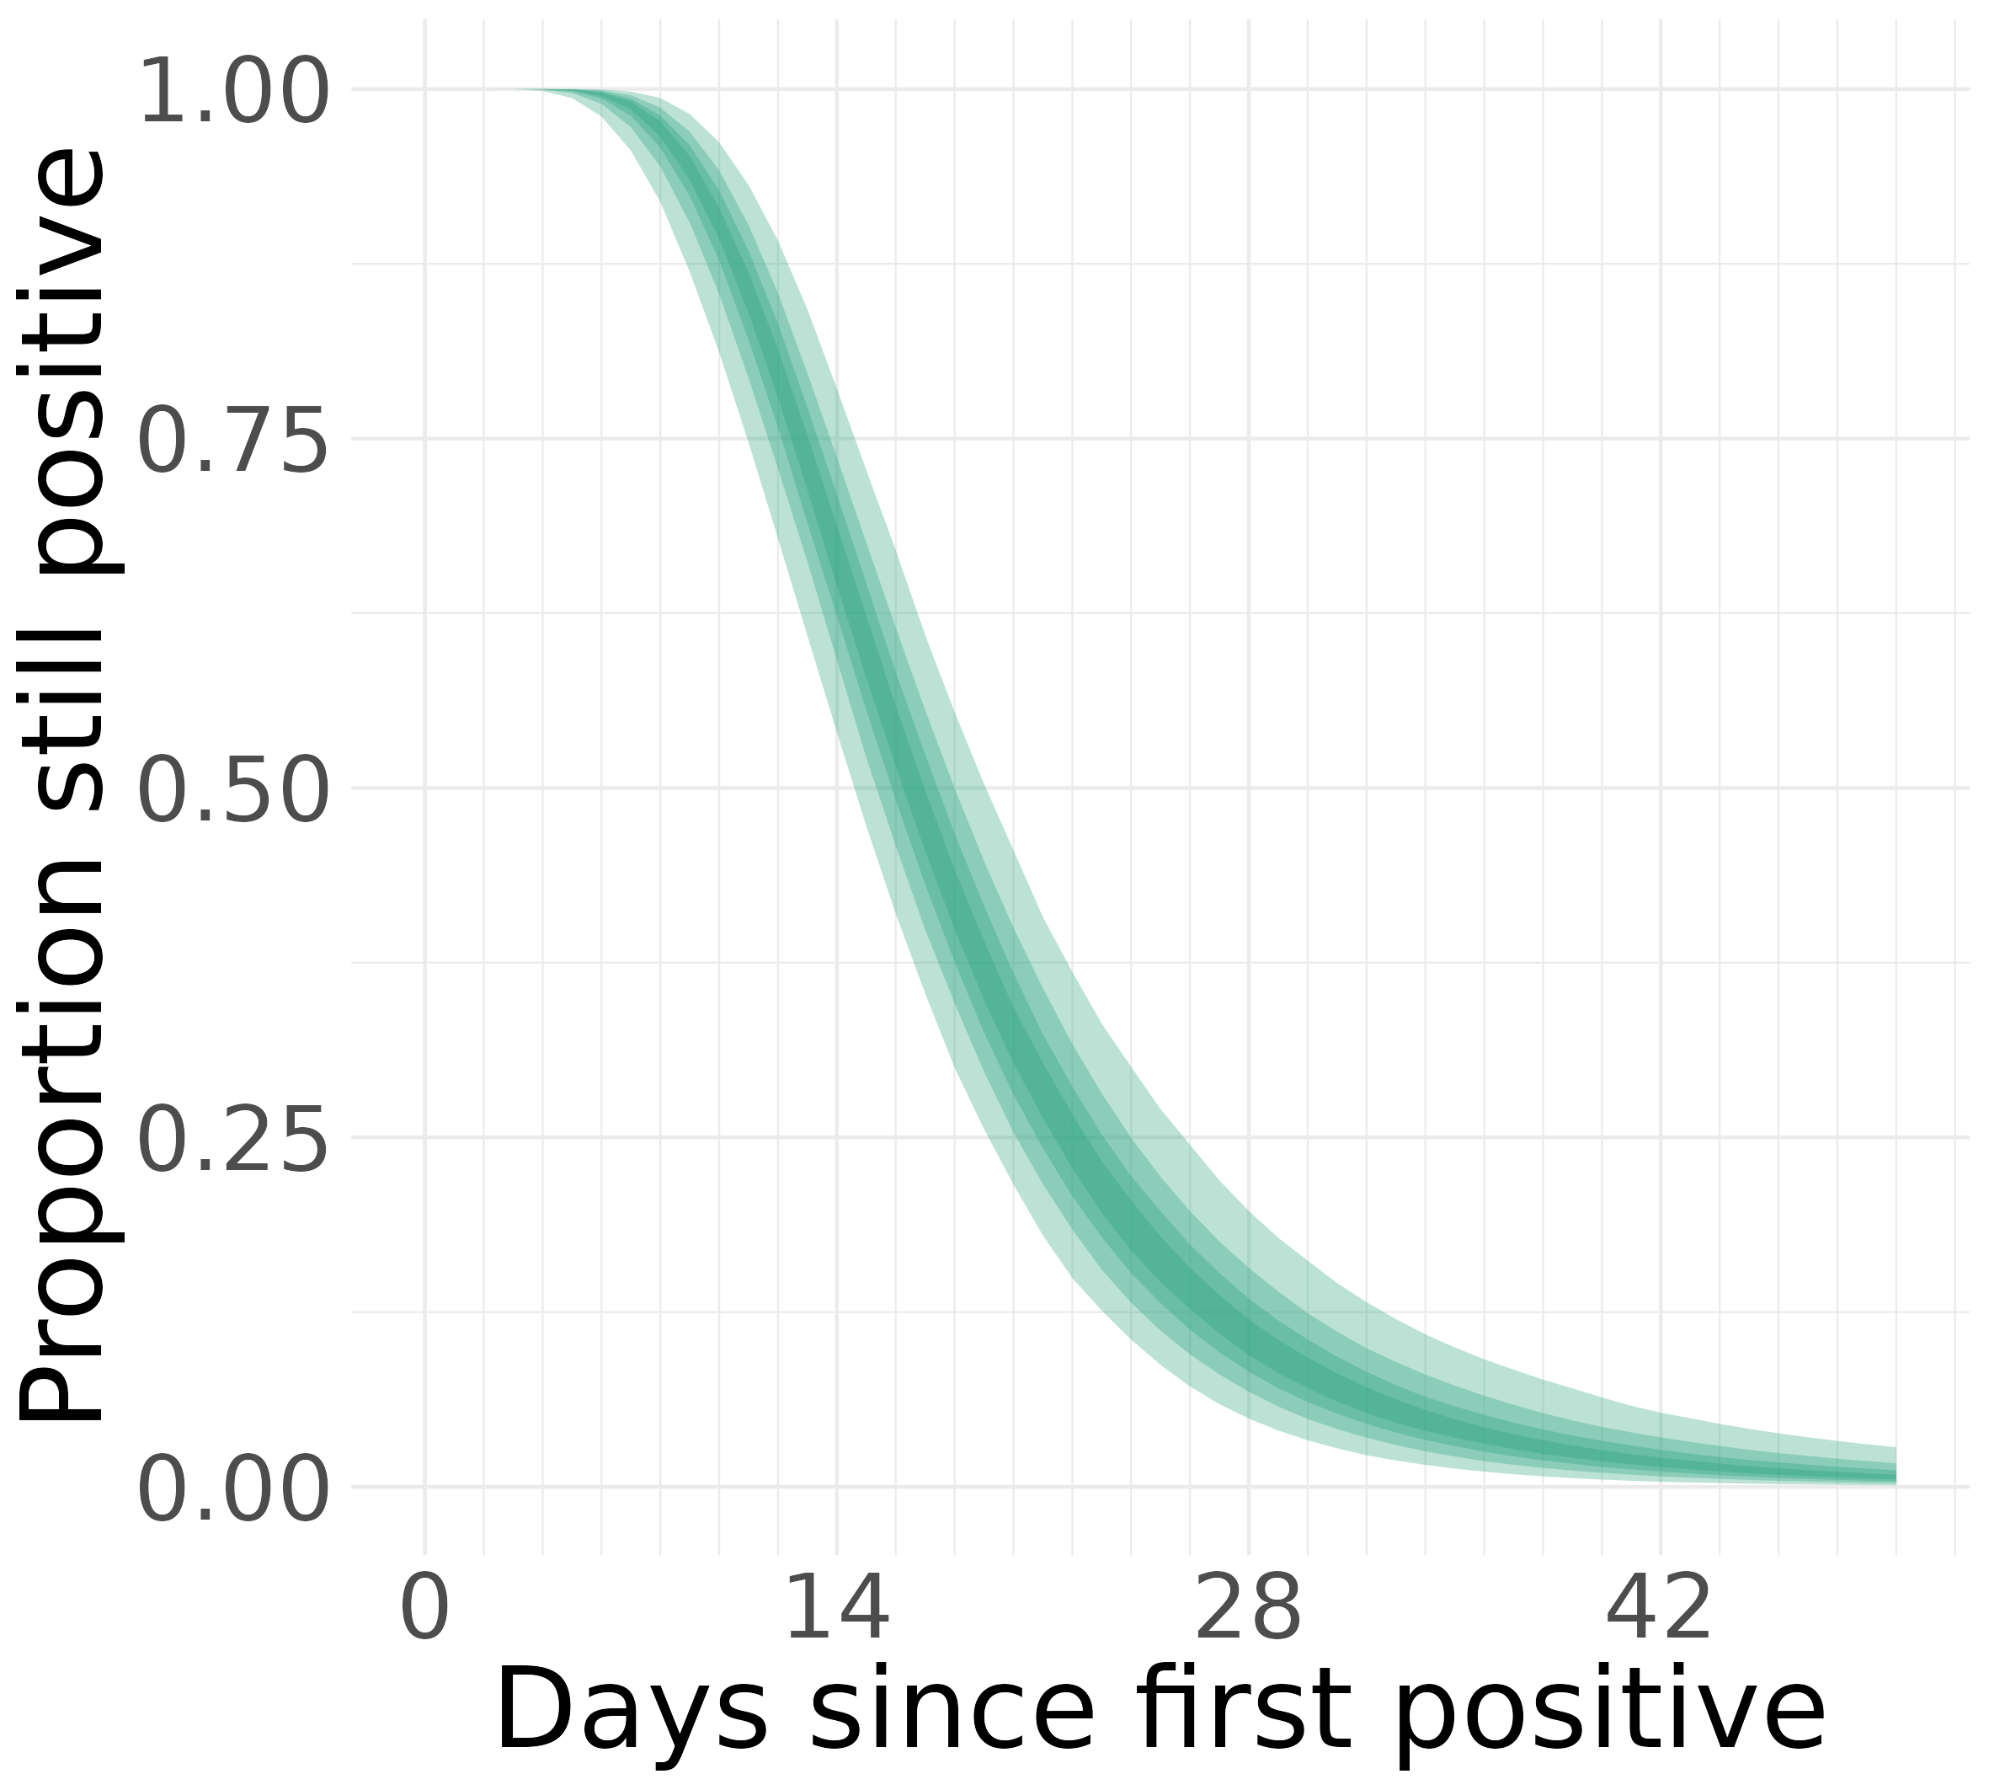
Duration results
Extrapolation based on
model assumptions
Notes:
Estimate of the survival: median, extrapolation
Timing: 4.5 min

Slide 15
CIS design
CIS data are statistical data from ONS which is Crown Copyright. The use of the ONS statistical data in this work does not imply the endorsement of the ONS in relation to the interpretation or analysis of the statistical data. This work uses research datasets which may not exactly reproduce National Statistics aggregates.
Notes:
Reminder of CIS design: each individual is tested weekly then monthly

Slide 16
Missed infections
CIS data are statistical data from ONS which is Crown Copyright. The use of the ONS statistical data in this work does not imply the endorsement of the ONS in relation to the interpretation or analysis of the statistical data. This work uses research datasets which may not exactly reproduce National Statistics aggregates.
Notes:
Infections can be missed. If we observe a series of negative tests for one individual there are two possibilities: either they were never infected or they were infected and recovered between tests.

Slide 17
Double interval censoring
CIS data are statistical data from ONS which is Crown Copyright. The use of the ONS statistical data in this work does not imply the endorsement of the ONS in relation to the interpretation or analysis of the statistical data. This work uses research datasets which may not exactly reproduce National Statistics aggregates.

Slide 18
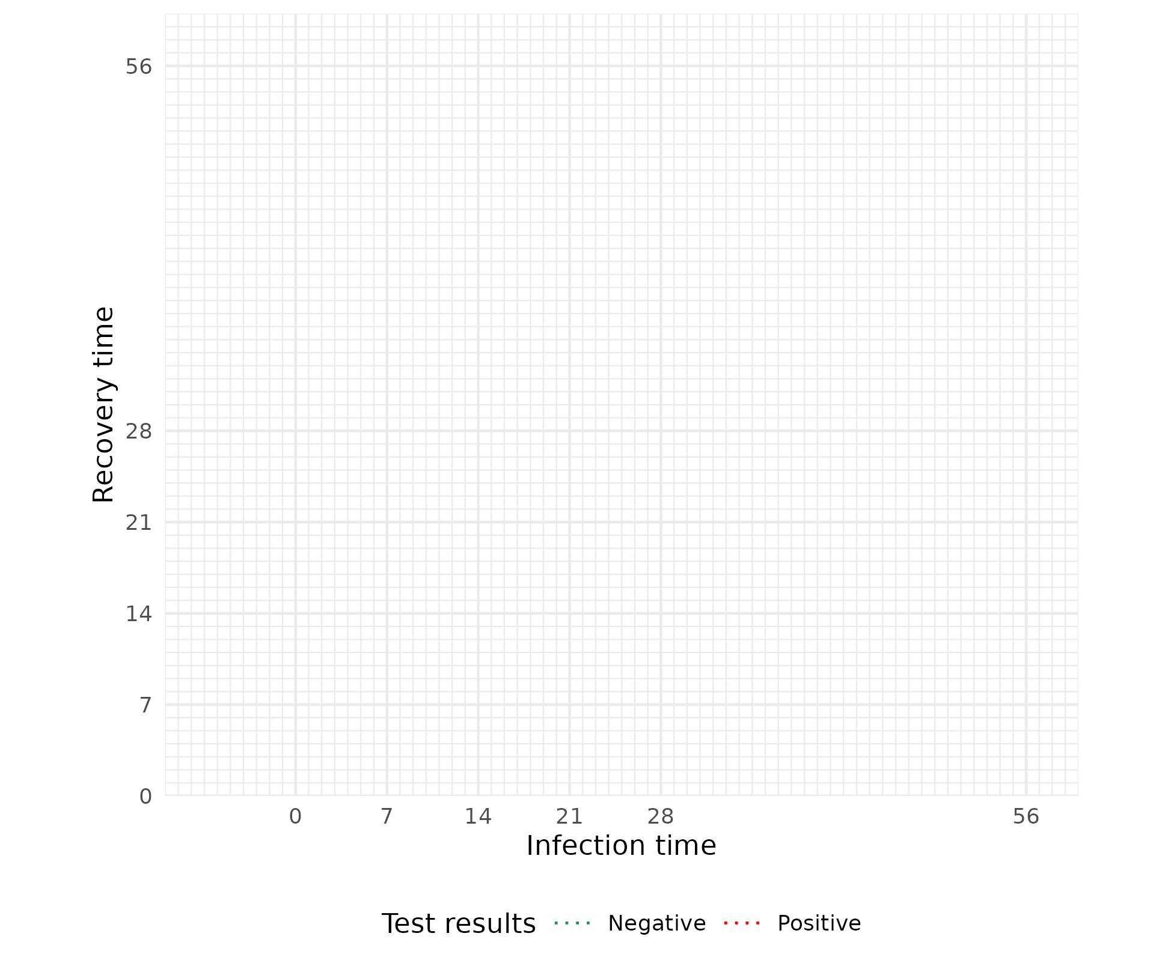
Likelihood
CIS data are statistical data from ONS which is Crown Copyright. The use of the ONS statistical data in this work does not imply the endorsement of the ONS in relation to the interpretation or analysis of the statistical data. This work uses research datasets which may not exactly reproduce National Statistics aggregates.
Notes:
Timing: 7-7.5 min

Slide 19
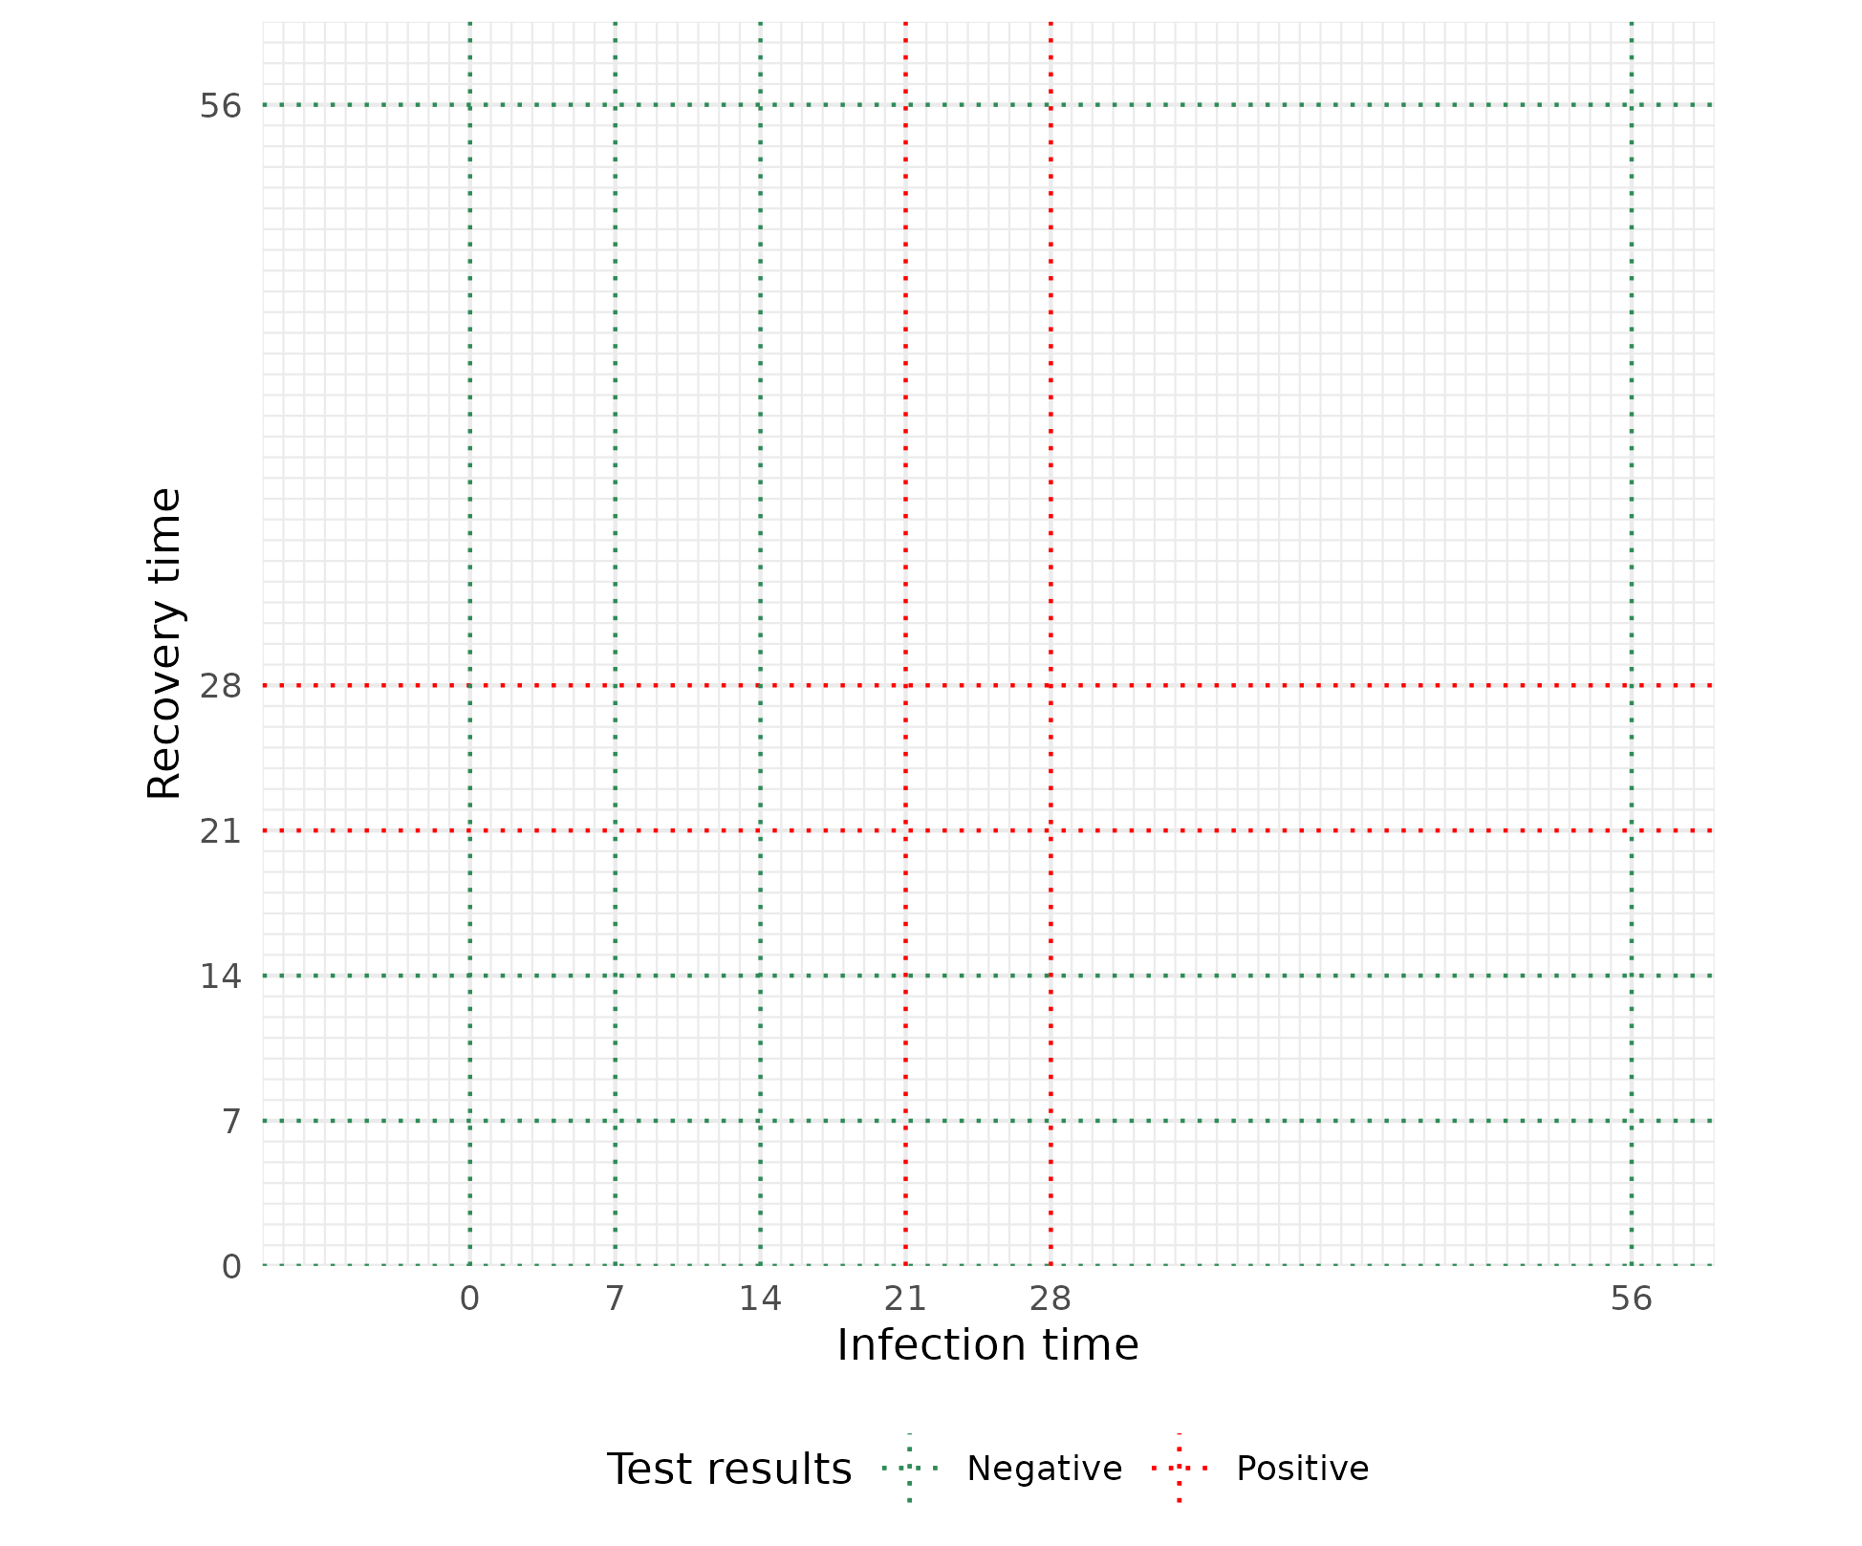
Likelihood
CIS data are statistical data from ONS which is Crown Copyright. The use of the ONS statistical data in this work does not imply the endorsement of the ONS in relation to the interpretation or analysis of the statistical data. This work uses research datasets which may not exactly reproduce National Statistics aggregates.
Notes:
Timing: 7-7.5 min

Slide 20
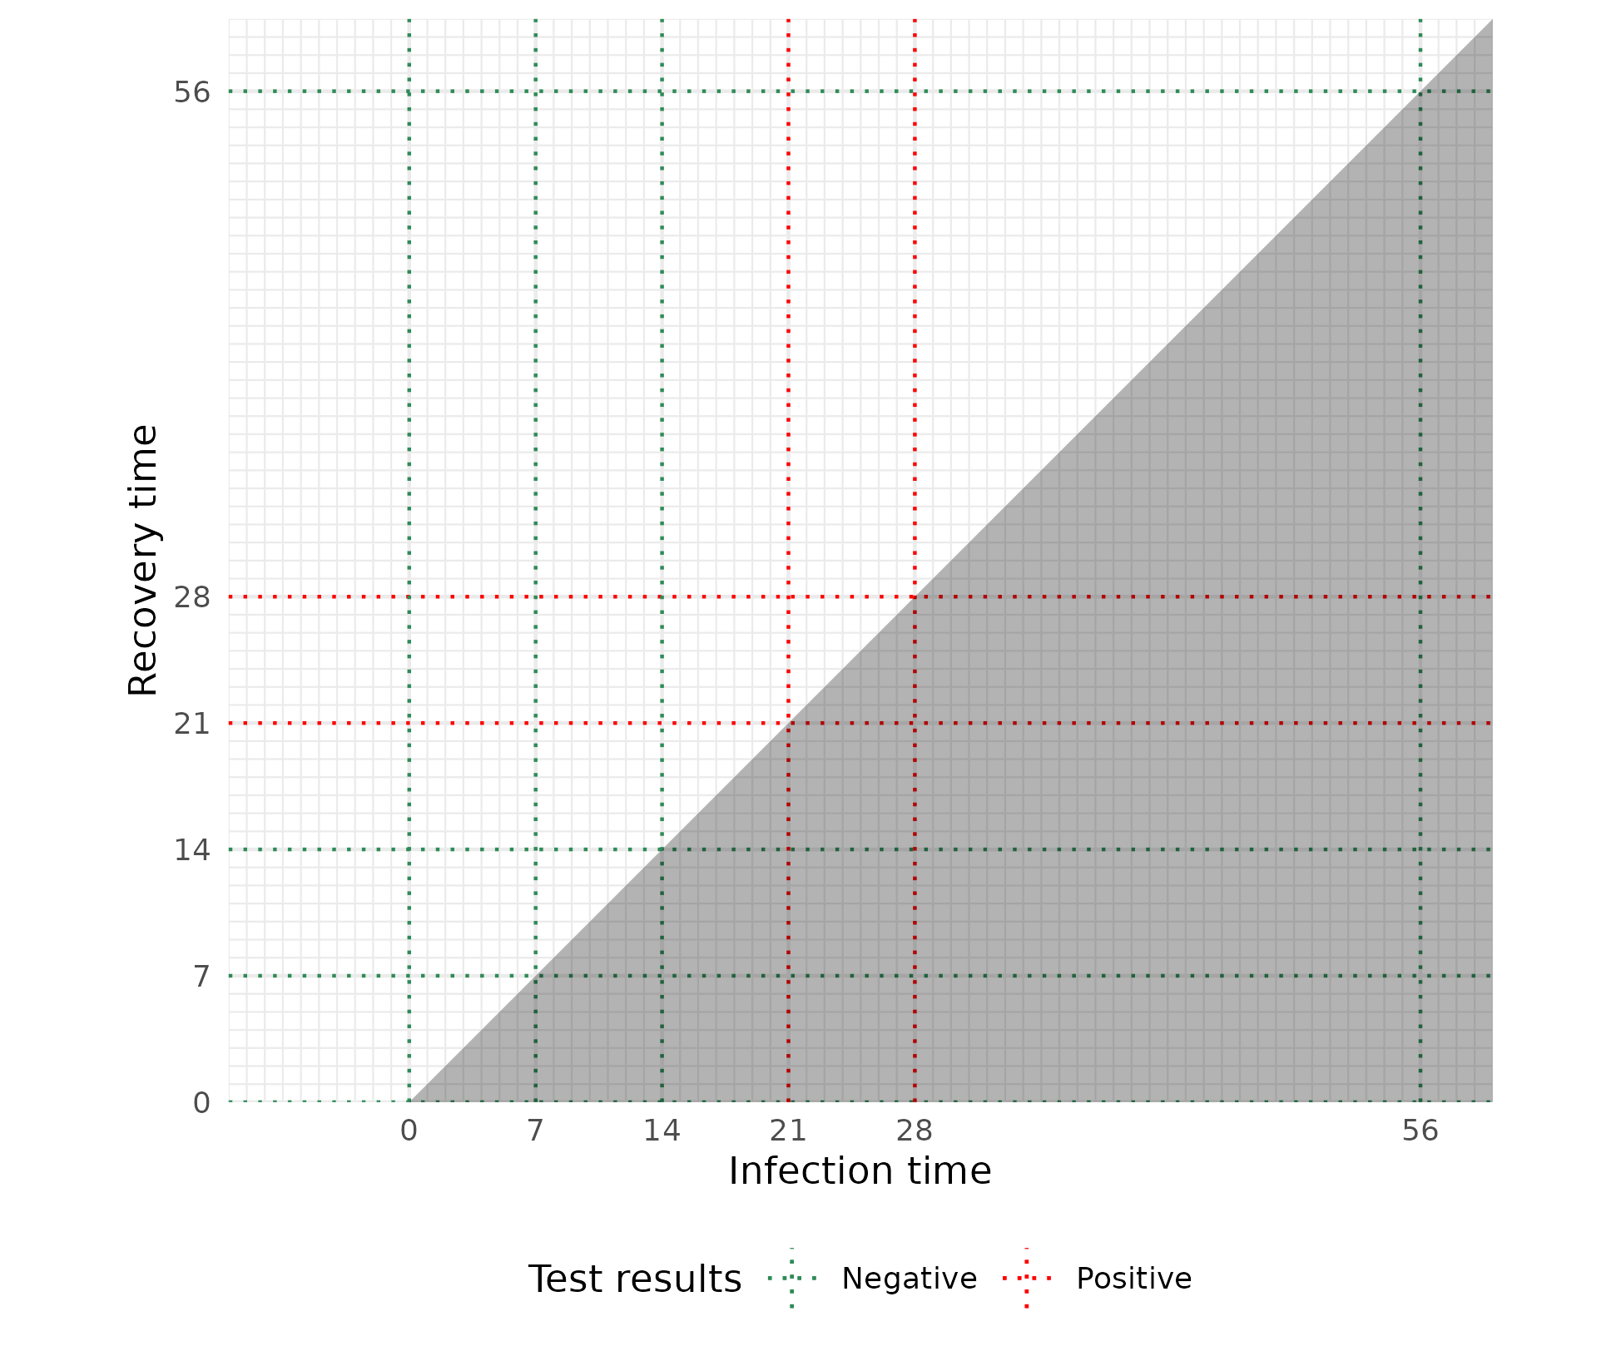
Likelihood
Impossible
CIS data are statistical data from ONS which is Crown Copyright. The use of the ONS statistical data in this work does not imply the endorsement of the ONS in relation to the interpretation or analysis of the statistical data. This work uses research datasets which may not exactly reproduce National Statistics aggregates.
Notes:
Timing: 7-7.5 min

Slide 21
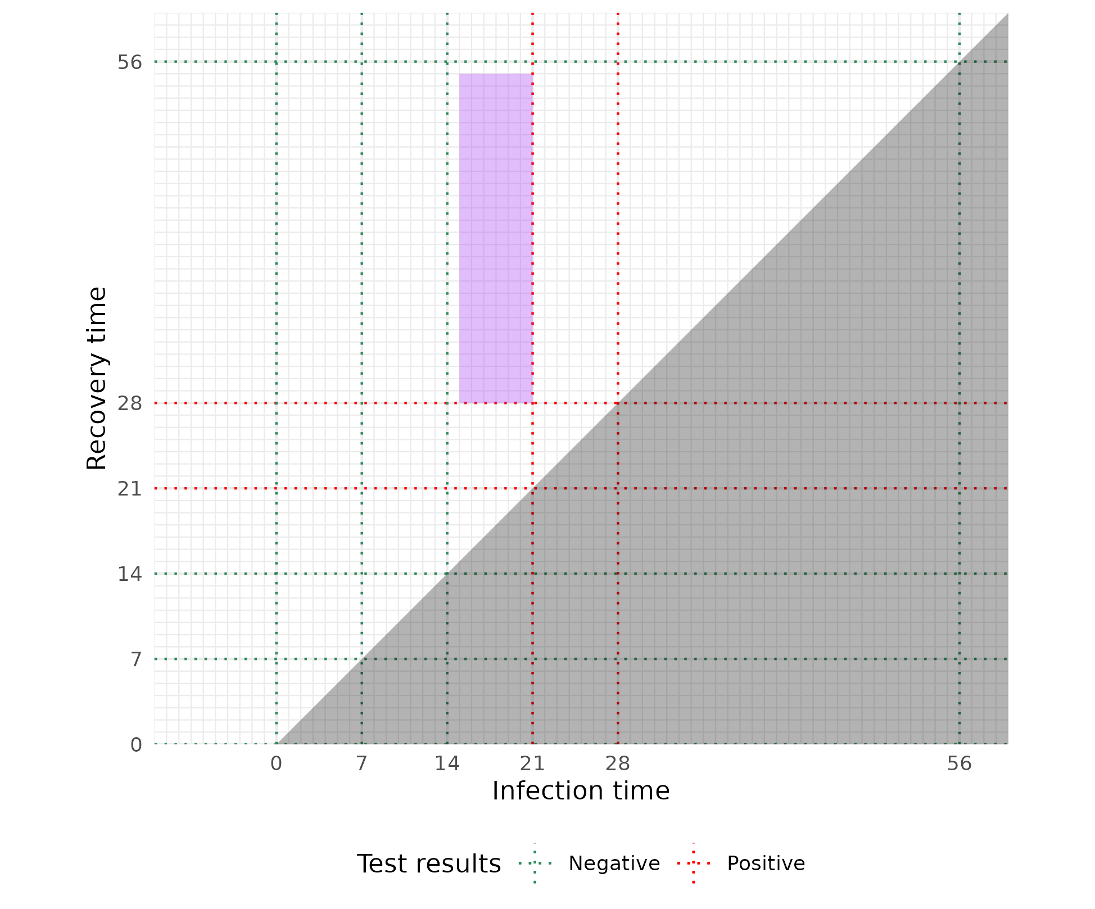
Likelihood
$$ℙ_{i}\left(observed infection∣θ\right)$$
Impossible
CIS data are statistical data from ONS which is Crown Copyright. The use of the ONS statistical data in this work does not imply the endorsement of the ONS in relation to the interpretation or analysis of the statistical data. This work uses research datasets which may not exactly reproduce National Statistics aggregates.
Notes:
Timing: 7-7.5 min

Slide 22
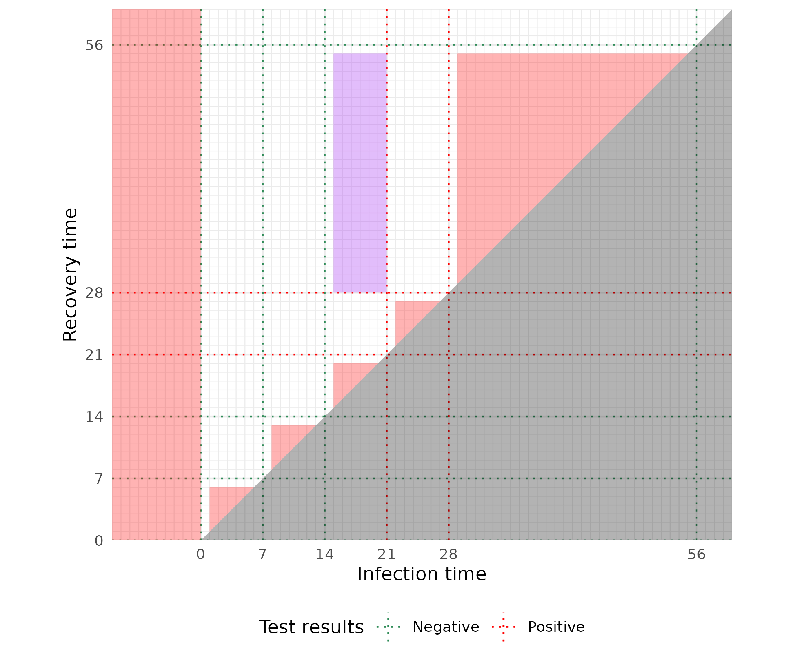
Likelihood
$$ℙ_{i}\left(observed infection∣θ\right)$$
$$ℙ_{i}{\left(miss infection∣θ\right)}^{}$$
Impossible
CIS data are statistical data from ONS which is Crown Copyright. The use of the ONS statistical data in this work does not imply the endorsement of the ONS in relation to the interpretation or analysis of the statistical data. This work uses research datasets which may not exactly reproduce National Statistics aggregates.
Notes:
Timing: 7-7.5 min

Slide 23
Posterior density
$$ℙ\left(θ ∣ data\right)∝p\left(θ\right)\prod_{i=1}^{n}{\left[ℙ_{i}\left(observed infection∣θ\right)\sum_{n_{miss}=0}^{∞}{ℙ_{i}{\left(miss infection∣θ\right)}^{n_{miss}}p\left(n_{miss}\right)}\right]}$$
CIS data are statistical data from ONS which is Crown Copyright. The use of the ONS statistical data in this work does not imply the endorsement of the ONS in relation to the interpretation or analysis of the statistical data. This work uses research datasets which may not exactly reproduce National Statistics aggregates.
Notes:
- \theta = parameters for survival curve
- High-level overview of what the posterior density looks like
- Observed lengths term: standard interval censoring
- Missed infections term: can be constructed from survival
- Both these terms include the false negative probabilities
- Summing over missed infections, considering as missing data

Slide 24
False negatives
?
CIS data are statistical data from ONS which is Crown Copyright. The use of the ONS statistical data in this work does not imply the endorsement of the ONS in relation to the interpretation or analysis of the statistical data. This work uses research datasets which may not exactly reproduce National Statistics aggregates.
Notes:
Final issue: false negatives
No time for details but can be incorporated into the probabilities
Timing: 8 min

Slide 25
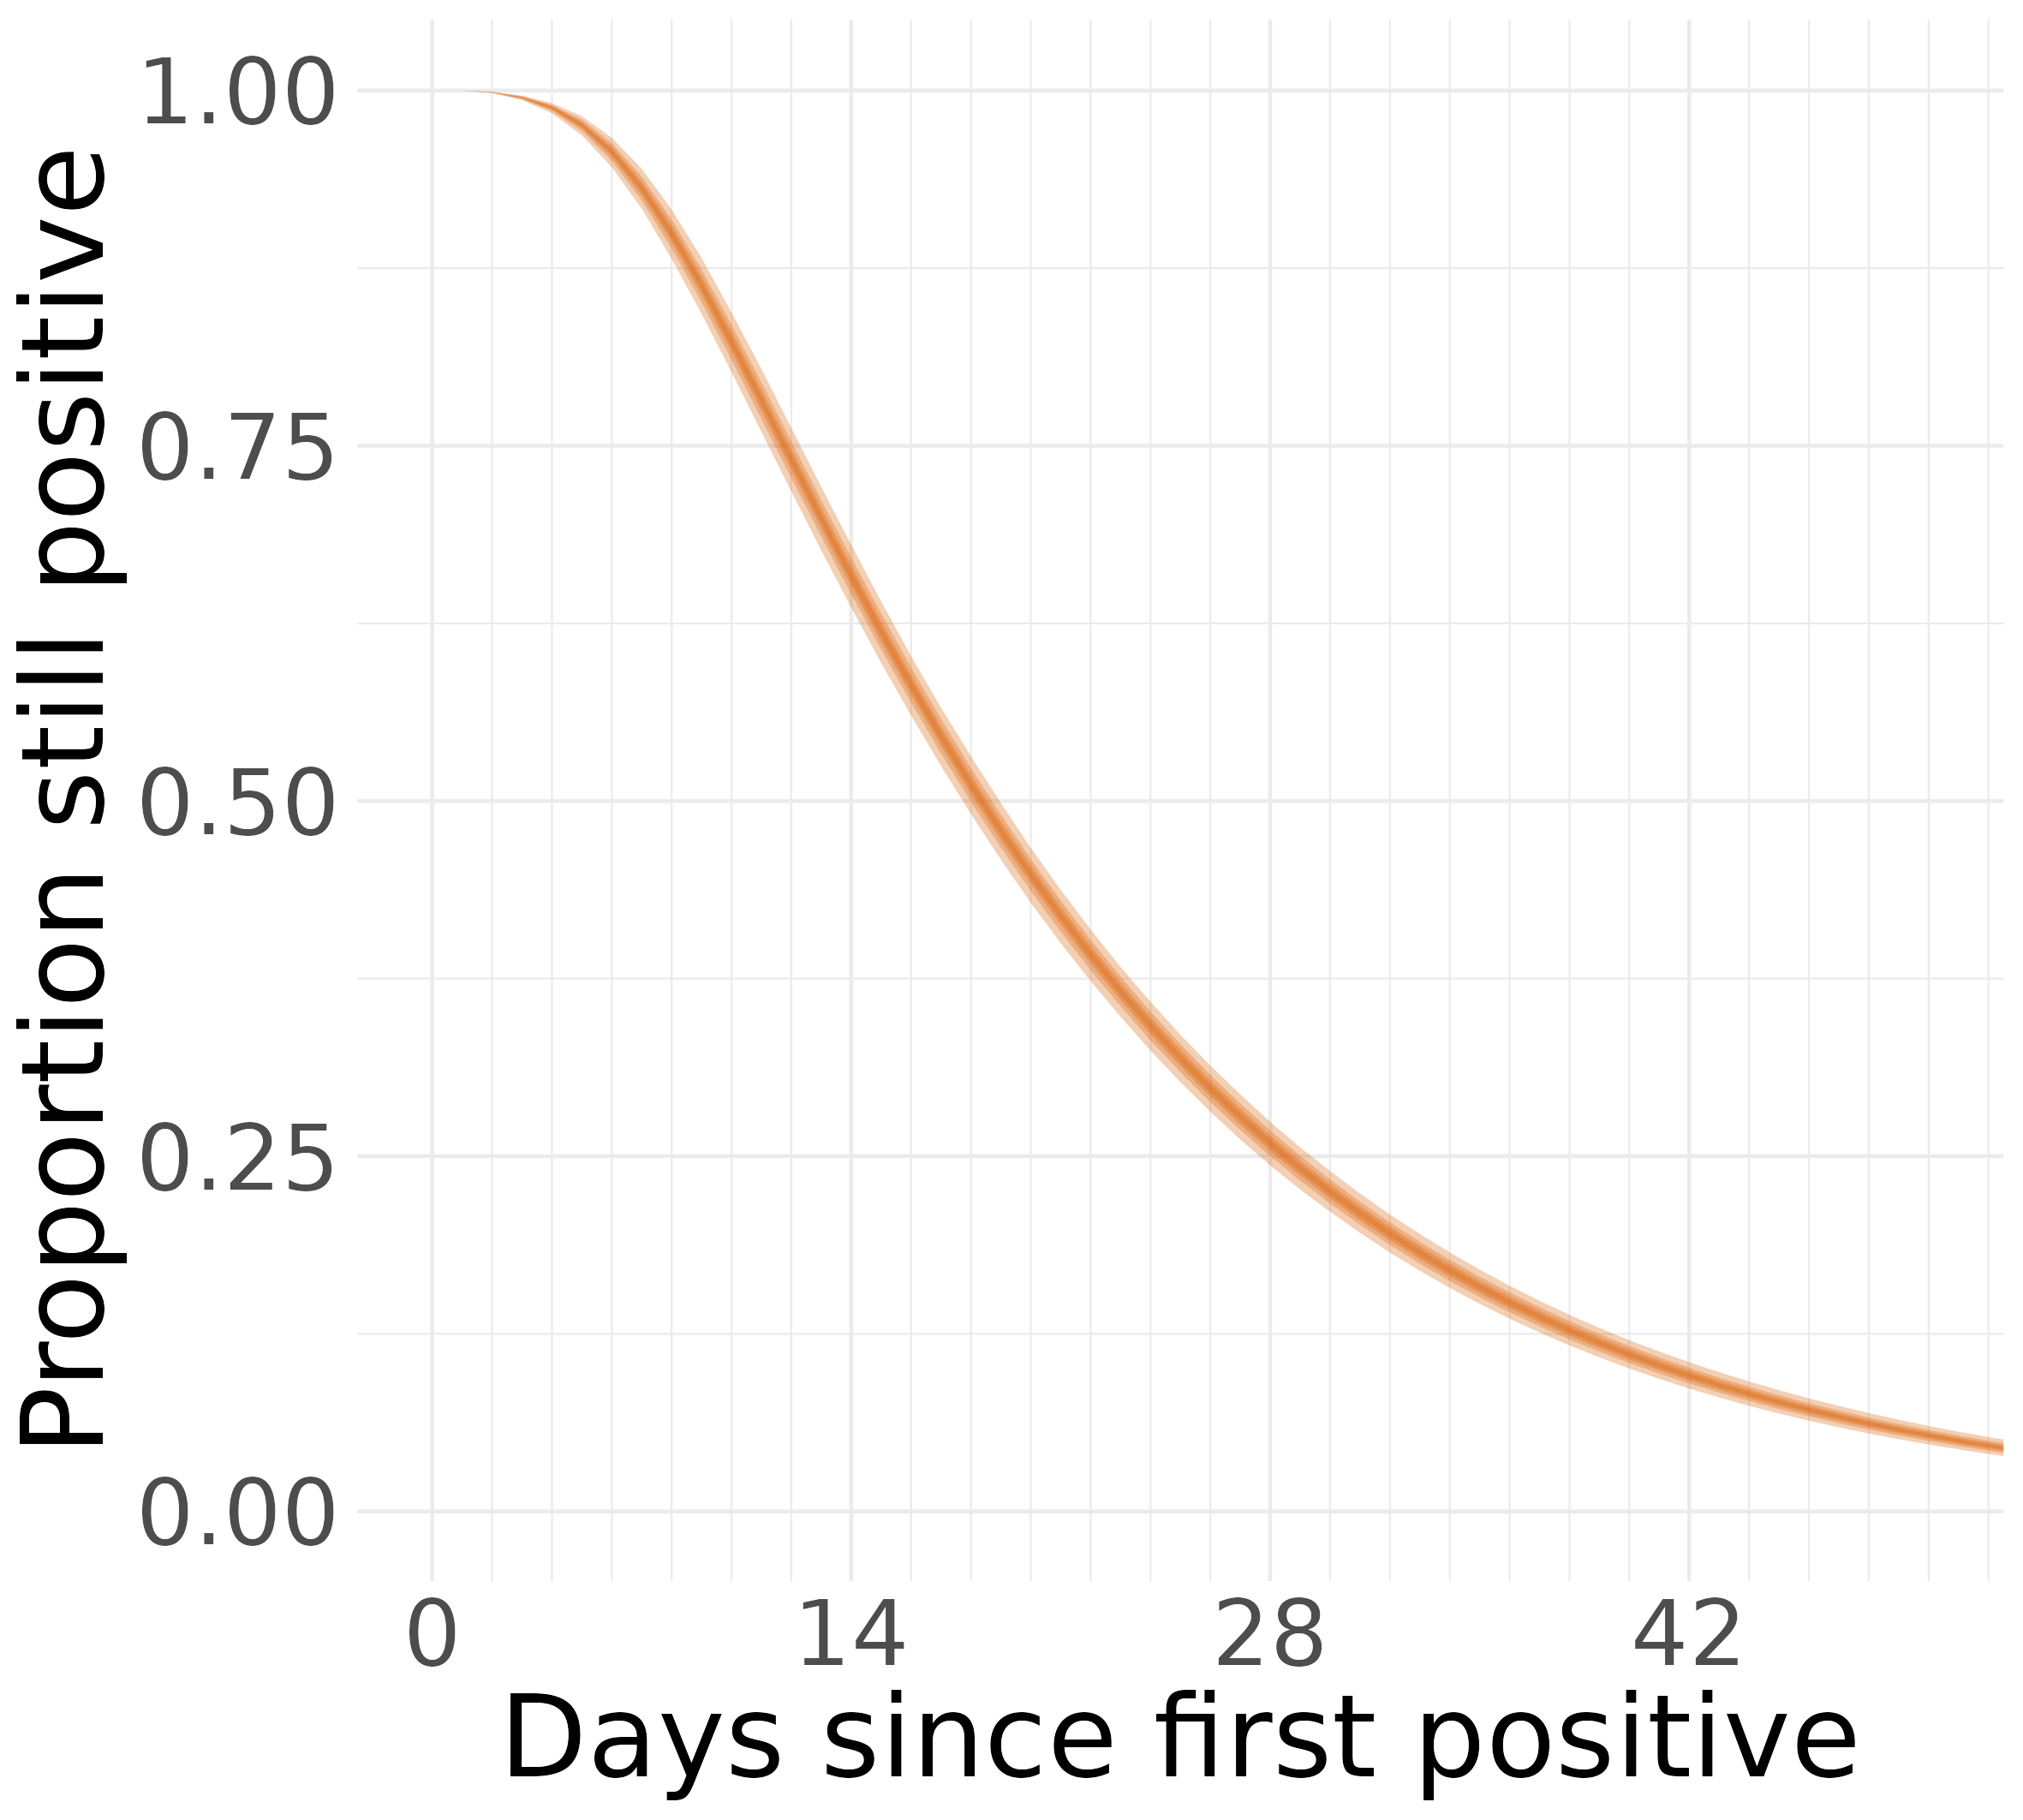
Results
Forced high levels of smoothing
CIS data are statistical data from ONS which is Crown Copyright. The use of the ONS statistical data in this work does not imply the endorsement of the ONS in relation to the interpretation or analysis of the statistical data. This work uses research datasets which may not exactly reproduce National Statistics aggregates.
Notes:
Timing: 8.5 min

Slide 26
Combination: methodology
Approximate ATACCC hazard posterior
$logit\left(h^{A}\right) \sim N\left(μ,Σ\right)$
Beta process prior based on $h^{A}$
$h_{t}^{CIS} |h^{A}\sim Beta\left(k_{t}h_{t}^{A}+α_{0},k_{t}\left(1−h_{t}^{A}\right)+β_{0}\right)$
CIS data are statistical data from ONS which is Crown Copyright. The use of the ONS statistical data in this work does not imply the endorsement of the ONS in relation to the interpretation or analysis of the statistical data. This work uses research datasets which may not exactly reproduce National Statistics aggregates.
Notes:
Skip if >10.5 min gone

Slide 27
Combination: methodology
Approximate ATACCC hazard posterior
$logit\left(h^{A}\right) \sim N\left(μ,Σ\right)$
Beta process prior based on $h^{A}$
$h_{t}^{CIS} |h^{A}\sim Beta\left(k_{t}h_{t}^{A}+α_{0},k_{t}\left(1−h_{t}^{A}\right)+β_{0}\right)$
$Beta\left(α_{0},β_{0}\right)$ is a vague default prior
CIS data are statistical data from ONS which is Crown Copyright. The use of the ONS statistical data in this work does not imply the endorsement of the ONS in relation to the interpretation or analysis of the statistical data. This work uses research datasets which may not exactly reproduce National Statistics aggregates.

Slide 28
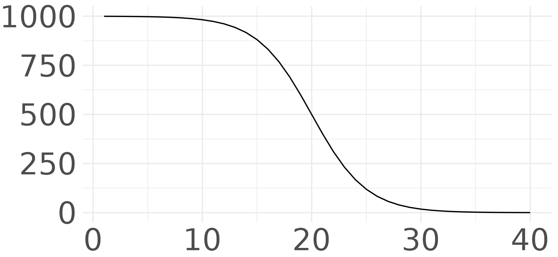
Combination: methodology
Approximate ATACCC hazard posterior
$logit\left(h^{A}\right) \sim N\left(μ,Σ\right)$
Beta process prior based on $h^{A}$
$h_{t}^{CIS} |h^{A}\sim Beta\left(k_{t}h_{t}^{A}+α_{0},k_{t}\left(1−h_{t}^{A}\right)+β_{0}\right)$
$k_{t}$ = belief in $h_{t}^{A}$
$Beta\left(α_{0},β_{0}\right)$ is a vague default prior
$$k_{t}$$
$$t$$
CIS data are statistical data from ONS which is Crown Copyright. The use of the ONS statistical data in this work does not imply the endorsement of the ONS in relation to the interpretation or analysis of the statistical data. This work uses research datasets which may not exactly reproduce National Statistics aggregates.
Notes:
Timing: 10-11min

Slide 29
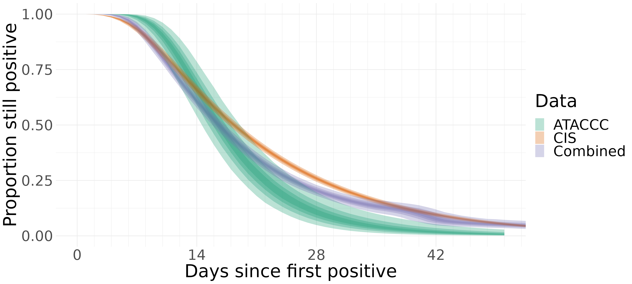
Combination: results
CIS data are statistical data from ONS which is Crown Copyright. The use of the ONS statistical data in this work does not imply the endorsement of the ONS in relation to the interpretation or analysis of the statistical data. This work uses research datasets which may not exactly reproduce National Statistics aggregates.
Notes:
Timing: 11 min

Slide 30
Conclusion and next steps
Sensitive to assumption on false negative rate
Sensitive to prior on number of infections missed
Suggest alternative CIS design so that ATACCC isn’t necessary
Investigate incidence estimation: many tests, few positives
Joint estimation of incidence and duration
Notes:
Timing: 11.5-11.75 min

Slide 31
Acknowledgements
Supervisors: Daniela De Angelis (BSU) and Paul Birrell (UKHSA)
Collaborators: Sarah Walker (Oxford), Thomas House (Manchester), Koen Pouwels (Oxford), and Theodore Kypraios (Nottingham)
ATACCC and CIS study teams and participants

Slide 32
Thank you
@JoshBiostats
joshuablake.co.uk
MRC Biostatistics Unit
@MRC_BSU
mrc-bsu.cam.ac.uk

